Slide 1


Slide 2

TL2 Status Report Presentation
By Connor Wolfe

Slide 3
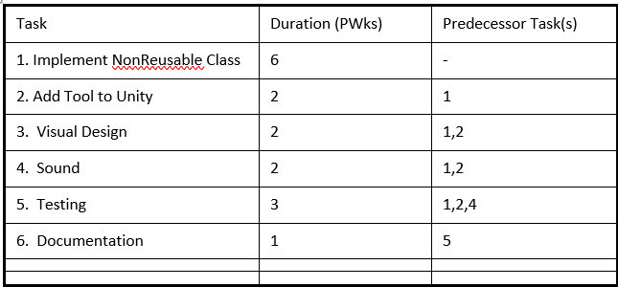

TL1: Tyler Gantt Chart

Slide 4
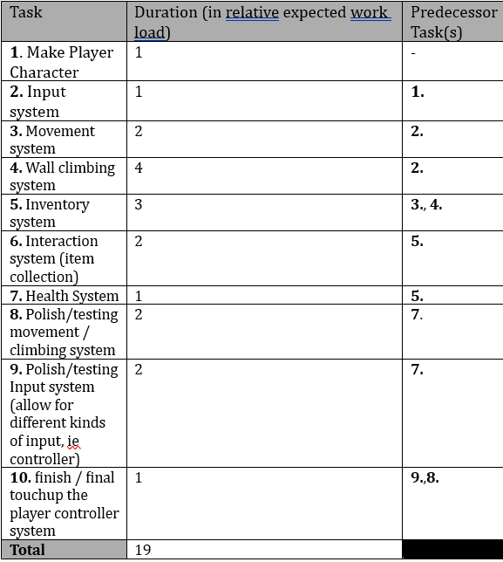
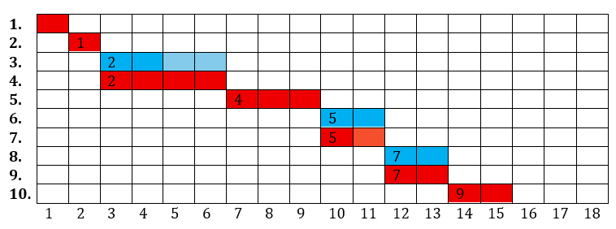
TL2: Connor gantt chart

Slide 5
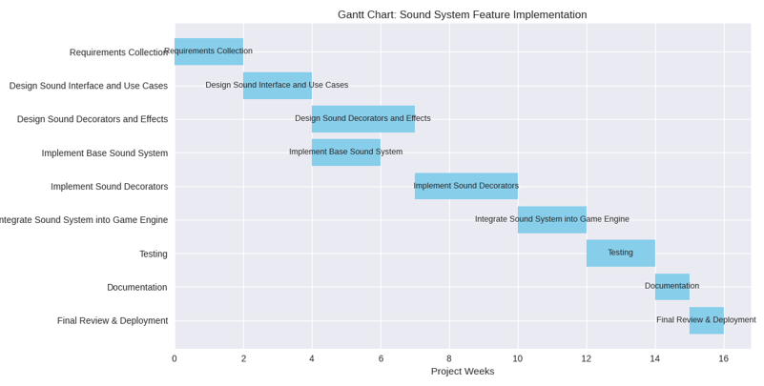
TL2+: Mikayla gantt chart

Slide 6
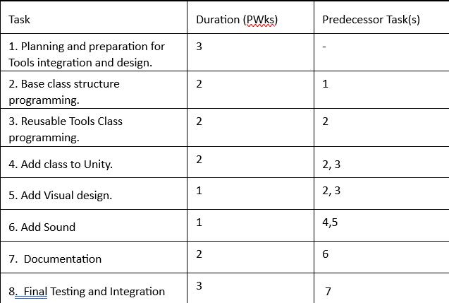
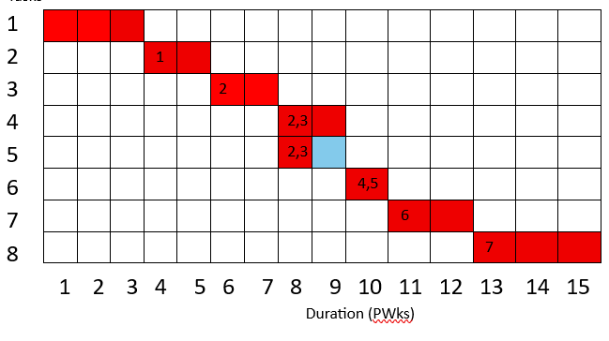
TL3: Jack gantt chart

Slide 7
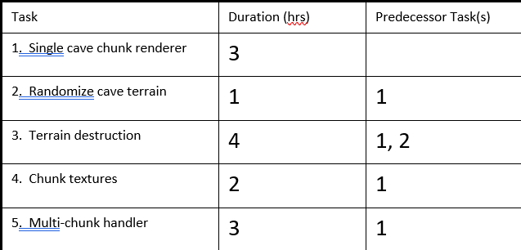

TL4: Mathew gantt chart

Slide 8
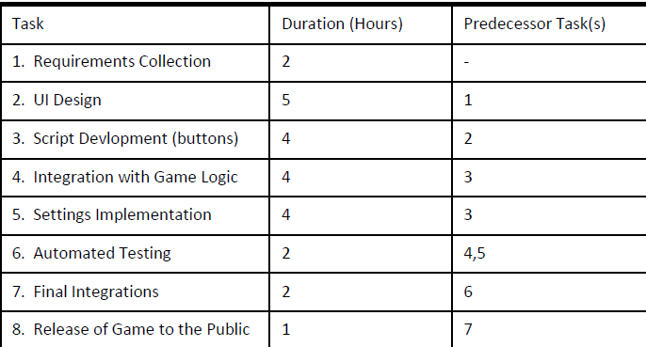

TL5: Luke gantt chart

Slide 9
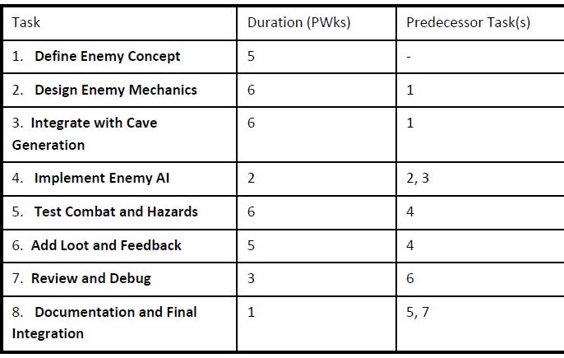
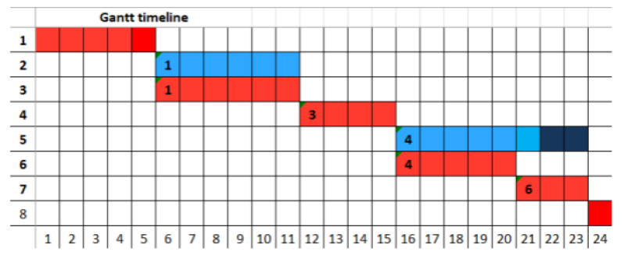
TL6: Arjun gantt chart

Slide 10
Now time for a class demo

